Slide 1
Docker Concepts
Foundation for Modern Apps
Ellis Paul, Senior TAM
March, 2021

Slide 2
Introduction
Introduction to Micro-service Architecture
Containers
Docker
Additional Information
Lab

Slide 3

Presentation and Playbook
Go grab a copy of the presentation and playbook to follow along
The playbook contains steps and commands we will be using
https://github.com/davemazur/tambootcamp-docker
https://gitlab.eng.vmware.com/atauber/tam-modern-apps

Slide 4
Introduction to Micro-Service Architecture

Slide 5
What’s Wrong with Traditional Applications
A quick example
Everything is tied to a single codebase
When one change is made, the entire application has to change
Application
Web/App Server
Database
Operating System

Slide 6
Reasons to Switch to Micro-services
Micro-services is an architectural style in which applications are decomposed into loosely coupled services
Increased resilience
Improved scalability
The right tool for the right task
Faster time to market
Easier debugging and maintenance
Micro-service UI
Micro-service
Micro-service
Micro-service
Micro-service

Slide 7
Containers

Slide 8
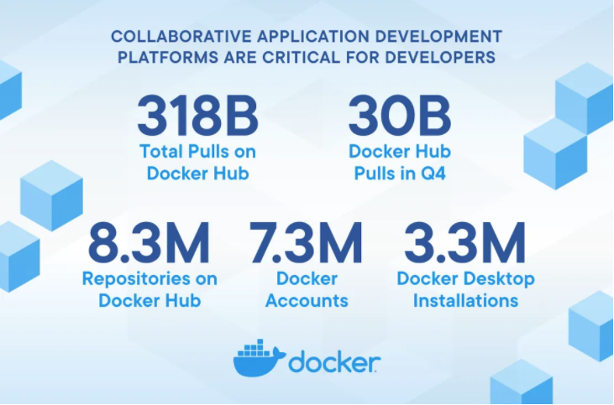
A Little Docker Data...
Notes:
Crazy numbers

Slide 9
What’s a Container?
Standard unit of software that packages up code and all of its dependencies
Containers help create a reproducible environment
You specify the exact version of:
Application
Different libraries
Different environment variables
Different configuration settings
Allow you to run your application in isolation inside that environment
Allows applications to run quickly and reliably from one computing environment to another
Core component in a micro-service architecture
Container
App A
App B
App C
Bins/Libs
Bins/Libs
Bins/Libs
Container Runtime
Host OS
Infrastructure

Slide 10
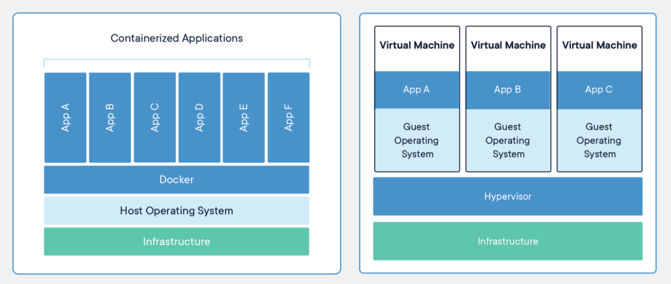
Containers vs VMs

Slide 11
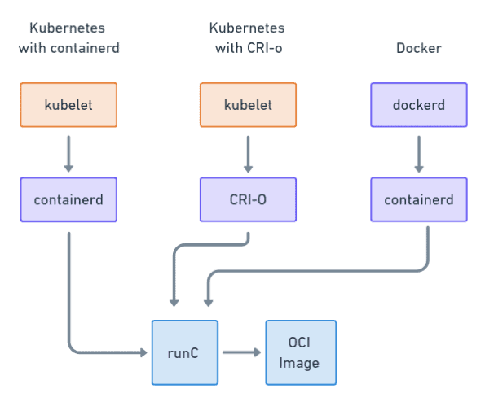
Container Runtime Formats see: https://www.capitalone.com/tech/cloud/container-runtime/ for more info
OCI is a runtime specification that describes how to unpack and run a container
runC is the OCI maintained implementation
OCI standard provides interoperability between container solutions
CRI
OCI Runtime

Slide 12
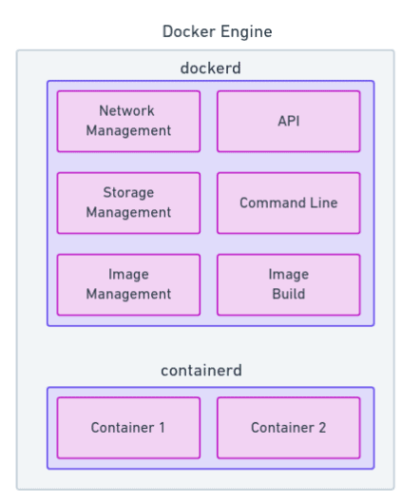
Docker Engine
Docker is divided into two services
Containerd
- managing containers
Dockerd
- everything else

Slide 13
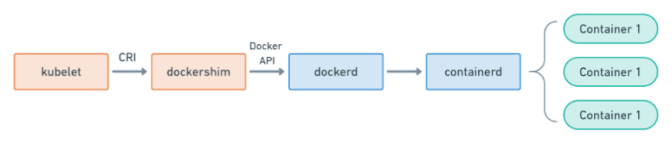
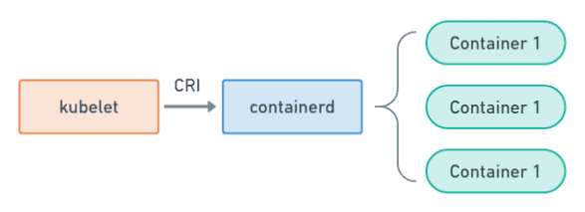
Dockershim Deprecation
Kubernetes is shifting away from Docker
Kubernetes with Docker Shim (currently being deprecated
Kubernetes with containerd

Slide 14
Docker

Slide 15
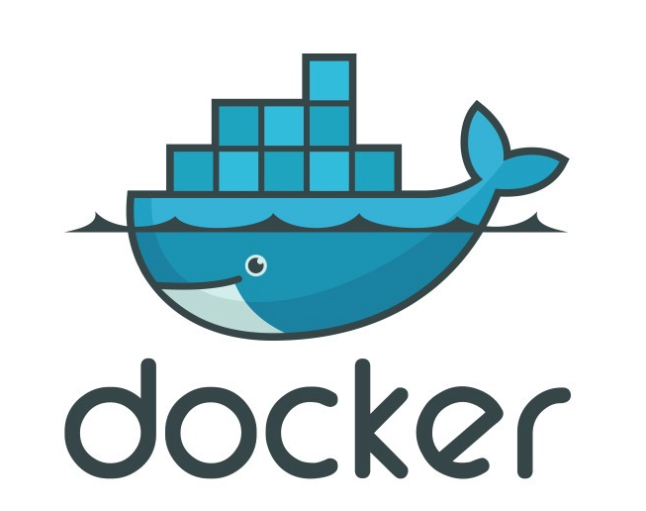
Docker Defined
Docker is a tool designed to make it easier to create, deploy and run applications using containers.

Slide 16
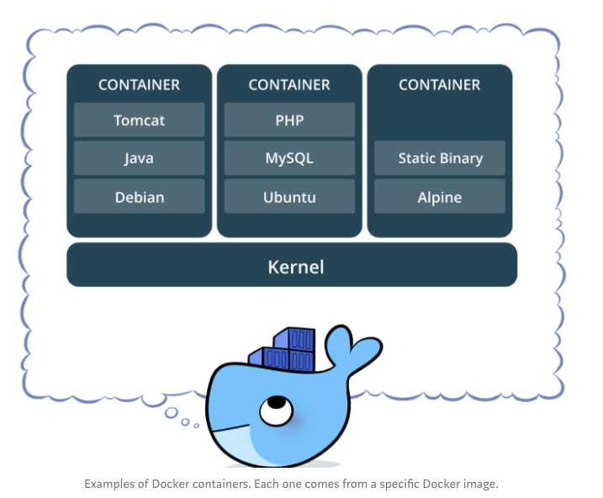
Container Examples

Slide 17
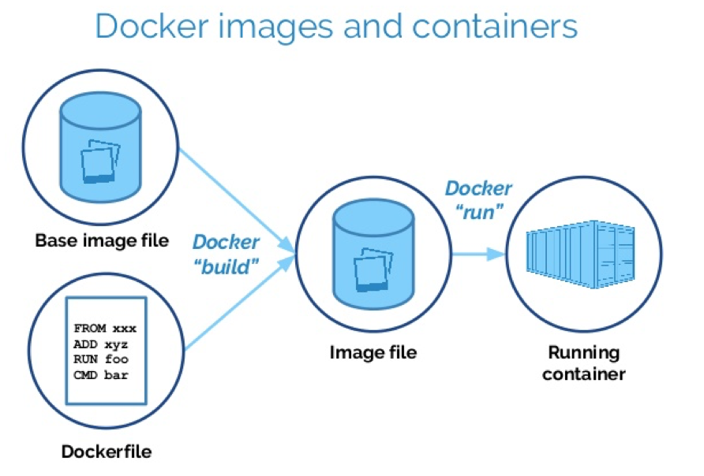
Basic Container Architecture
Images
Storage
Network
Plugins

Slide 18
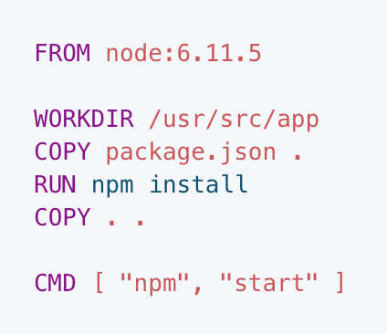
Dockerfile
Text document
Contains all commands to build an image
The docker build command reads the Dockerfile and uses that to build an image

Slide 19
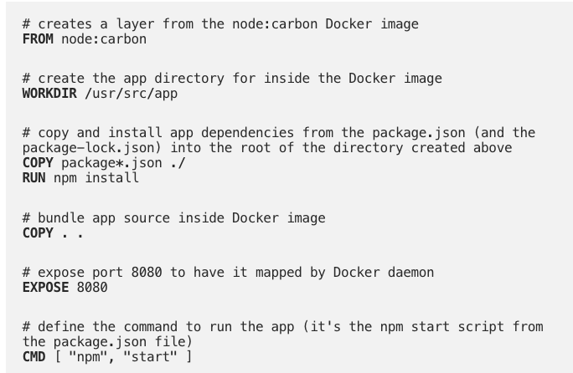
Dockerfile Example

Slide 20
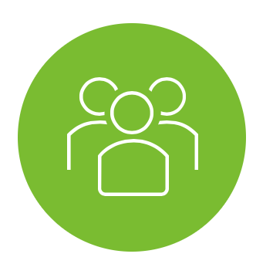

Docker Flow
Users
Container
Container
Docker Registry
App A
App B
Push Image
Bins/Libs
Bins/Libs
3
4
1
Docker Client
Start instance of image
Place screenshot here
API
Docker Runtime (dockerd)
2
Host OS
Version Control
Build Image
Infrastructure
Docker File for A
Docker File for B

Slide 21
Basic Docker Commands
docker build {creates an image}
docker images {list images (and their repository)}
docker run (-d daemon mode)
docker ps {see running containers} / docker ps -a [see running and stopped containers}
docker stop/start {stop allows you to later restart the container}
docker exec {run a cmd in a running container}
docker push/pull
docker rm {remove the container completely}
docker rmi {remove the image}

Slide 22
Other Useful Docker Commands
docker kill $(docker ps -q) {kill all running containers}
docker rm $(docker ps -a -q) {delete all stopped containers}
docker rmi $(docker images -q) docker rmi $(docker images -q) {delete all images}
docker logs <container-ID>dock

Slide 23
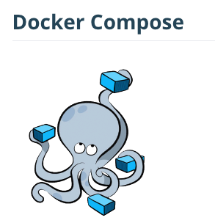
Docker Compose
Tool for defining and running multi-container docker applications
Manages the application life cycle
Start, stop, rebuild services
View the status of running services
Stream the log output of running services
Run a one off command
Build several images at once, start several containers

Slide 24
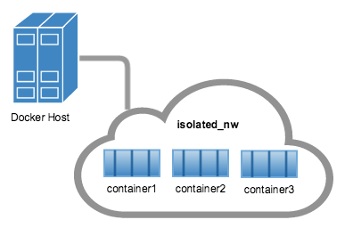
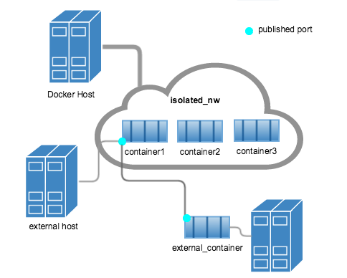
Docker Networks
Bridge
default, used in standalone container
Host
swarm, remove network isolation between container and docker host
Overlay
Overlay networks connect multiple Docker daemons together and enable swarm services to communicate with each other
Macvlan
allow you to assign a MAC address to a container, making it appear as a physical device on your network
None
disable all networking

Slide 25
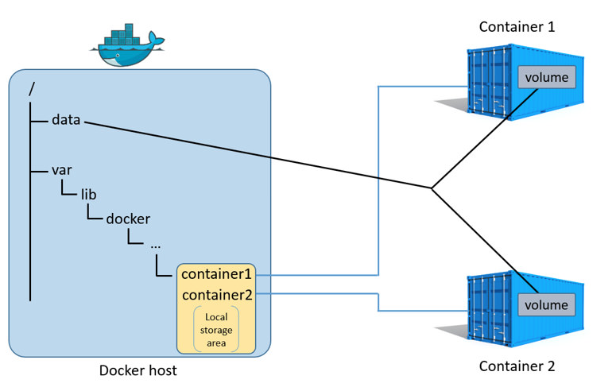
Docker Storage
Means of persistent storage
Otherwise everything we did goes away
Typical persistent data
Log files, databases, JSON files
Basic commands
docker volume create
docker volume ls
docker volume prune
docker volume rm
docker inspect [name of volume]
attach a volume to a container
docker run -d -p 8000:3000 --name my-container --volume my-volume:/xxx/yyy

Slide 26
Docker Plugins
Out-of-process extensions that add capabilities to the docker engine
Run on the same or different host as the docker engine
Registers itself with Docker
Can run inside or outside containers (running outside is recommended)
Docker Plugin API
https://docs.docker.com/engine/extend/plugin_api/
Examples
IPAM
Network drivers
Authorization
Docker Engine
Container
App A
IPAM Plugin
Bins/Libs
IPAM
Notes:
Sidecar applications

Slide 27
Docker Swarm
Orchestration
Dockers version of cluster management and orchestration
Native to Docker
Provides tools for scaling, networking, securing and maintaining your apps

Slide 28
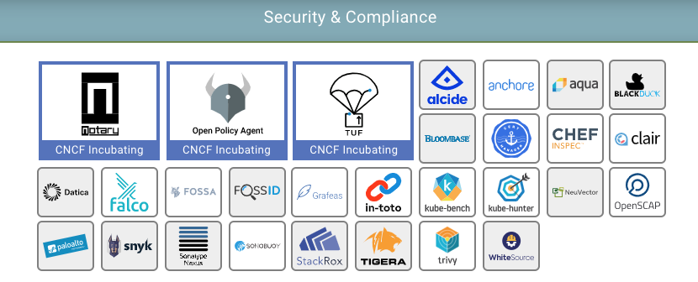
Security Concerns
Unsecured communication and unrestricted network traffic
Unrestricted access of process and files
Kernel level threats
Inconsistent update and patching of docker containers
Unverified docker images

Slide 29
Product Example
Using Containers/Micro-Services

Slide 30
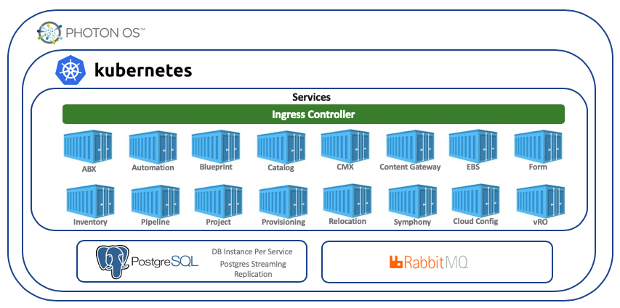
vRealize Automation 8.0

Slide 31
Additional Information

Slide 32
Information and Tutorials
Docker step-by-step tutorial
https://docs.docker.com/get-started/
https://linuxacademy.com/blog/docker/6-years-of-docker-hands-on-docker-training/
Cloud Native Computing Foundation
https://landscape.cncf.io/
Cloud Native Applications (CNABU)
https://confluence.eng.vmware.com/pages/viewpage.action?pageId=115976924

Slide 33
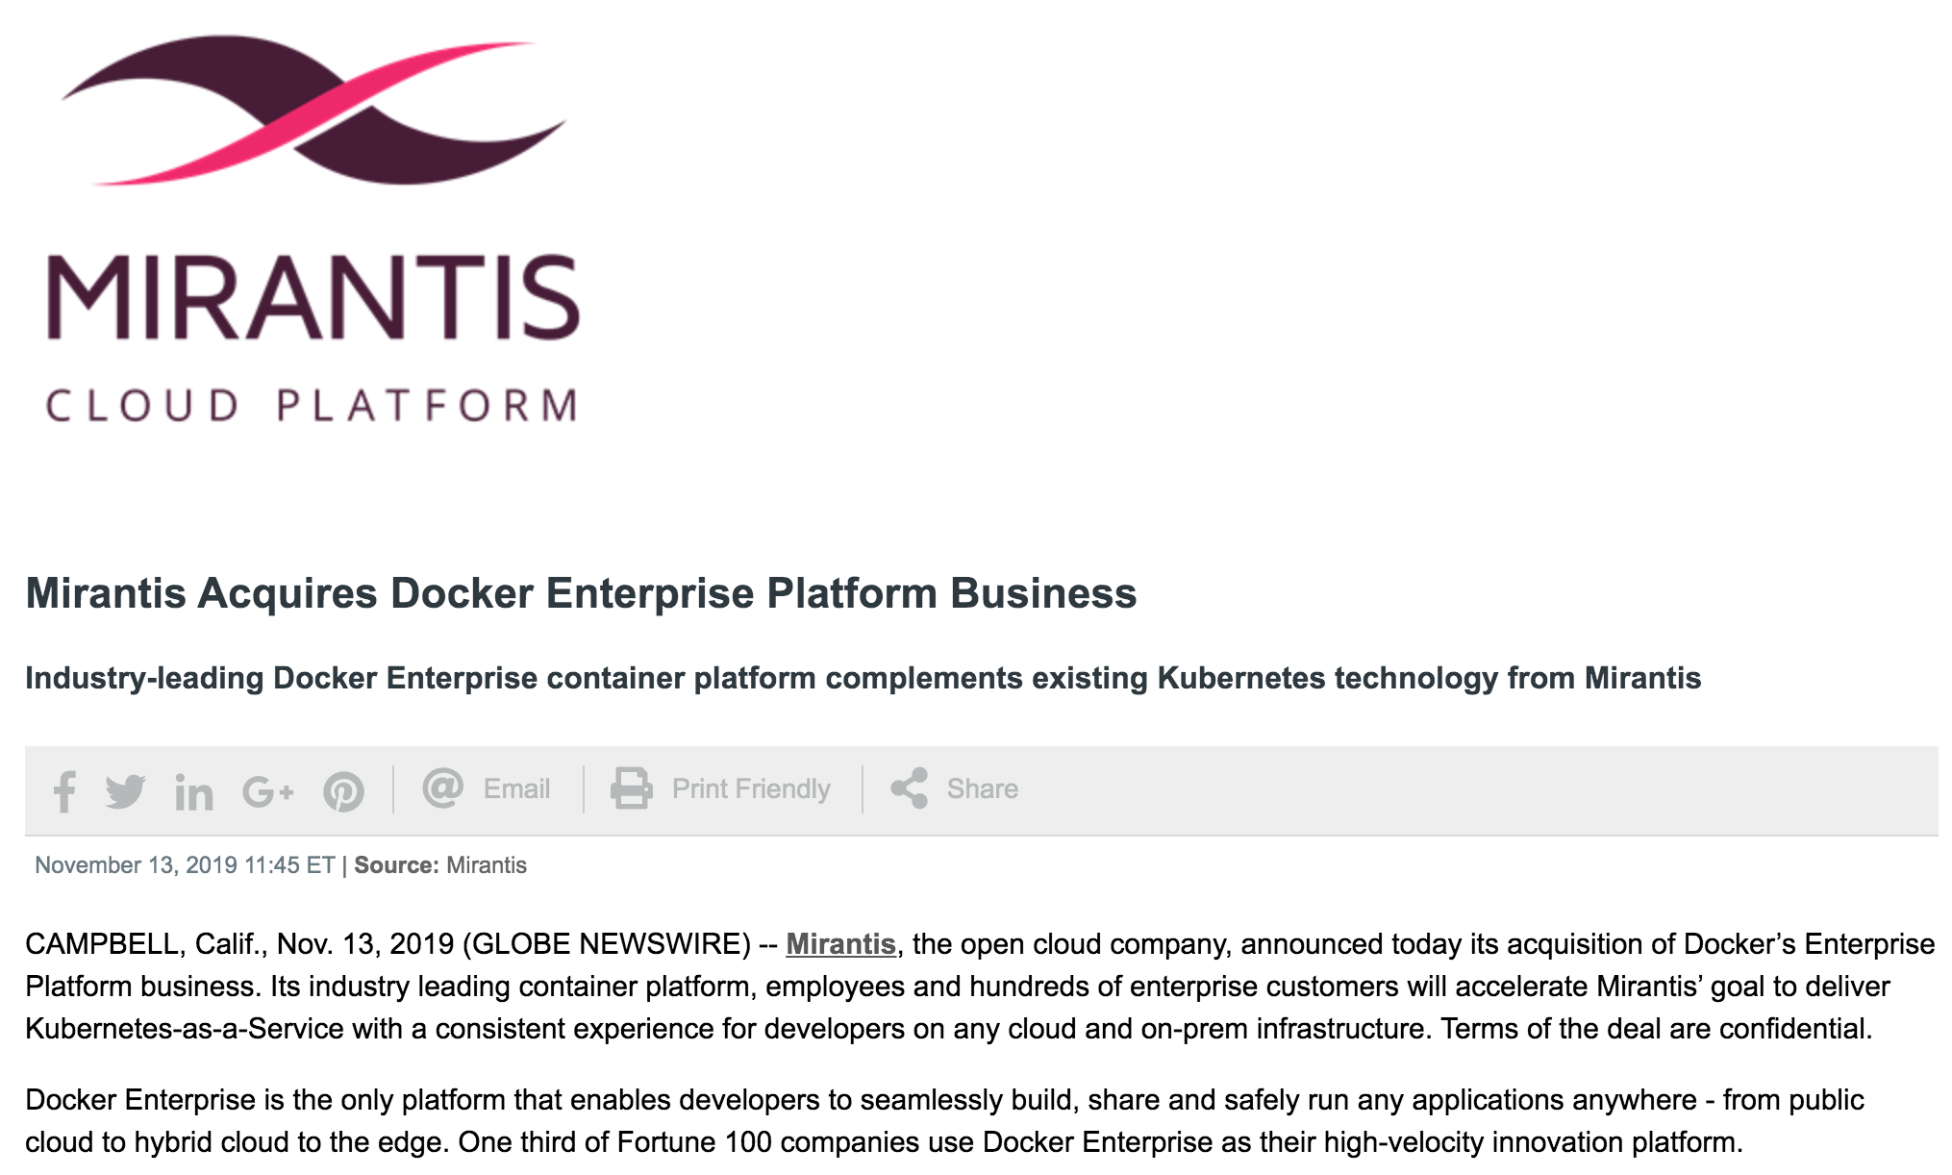
Mirantis Acquires Docker

